Slide 1
Computer Performance and Cache Memory
Muhammad Afzaal
m.afzaal@nu.edu.pk

Slide 2
Book Chapter
“Computer Organization and Architecture”
Author “William Stallings”
8th Edition
Chapter 2
Section 2.2
Chapter 4
Section 4.1
Section 4.2
Section 4.3

Slide 3
Designing for Performance
Cost of systems continues to drop whereas performance and capacity continue to rise
Today application programs are very complex and power hungry
Image processing
Speech recognition
Videoconferencing
Multimedia authoring
Simulation modeling
We have to see how can we use the microprocessor in a way to utilize all it’s clock cycles

Slide 4
Microprocessor Speed
Processor is not used at its full throttle always
How to keep processor busy and get maximum out of it?
Branch Prediction
Processor predicts which branches or groups of instructions are likely to be executed next
Data Flow Analysis
Processor analyzes which instructions are dependent on each other
Speculative Execution
Processors execute instructions ahead of their actual appearance in the program execution

Slide 5
Performance Balance
Processor power has increased rapidly
… what about the speed of other components of computer?
Slow data transfer rate between main memory and processor
If memory fails to keep pace with processor, the processor has to stall in a wait state

Slide 6
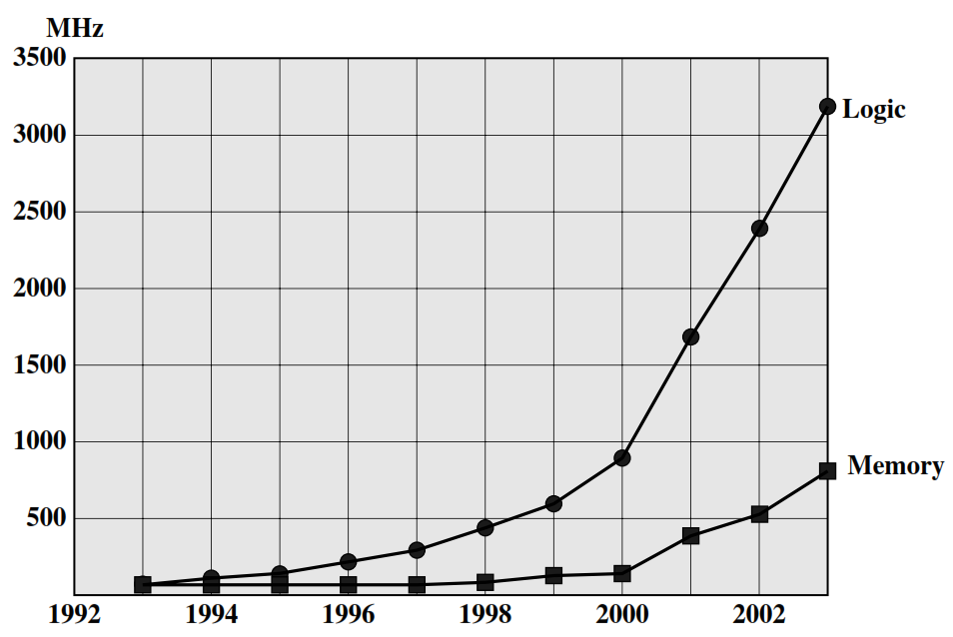
Processor and Memory Performance Gap

Slide 7
Some Tips to Increase Speed
How to tackle this problem of speed between processor and main memory?
Increase data bus size
Include a cache in DRAM to make it more efficient
Reduce frequency of memory access
Increase the interconnect bandwidth between processor and memory

Slide 8
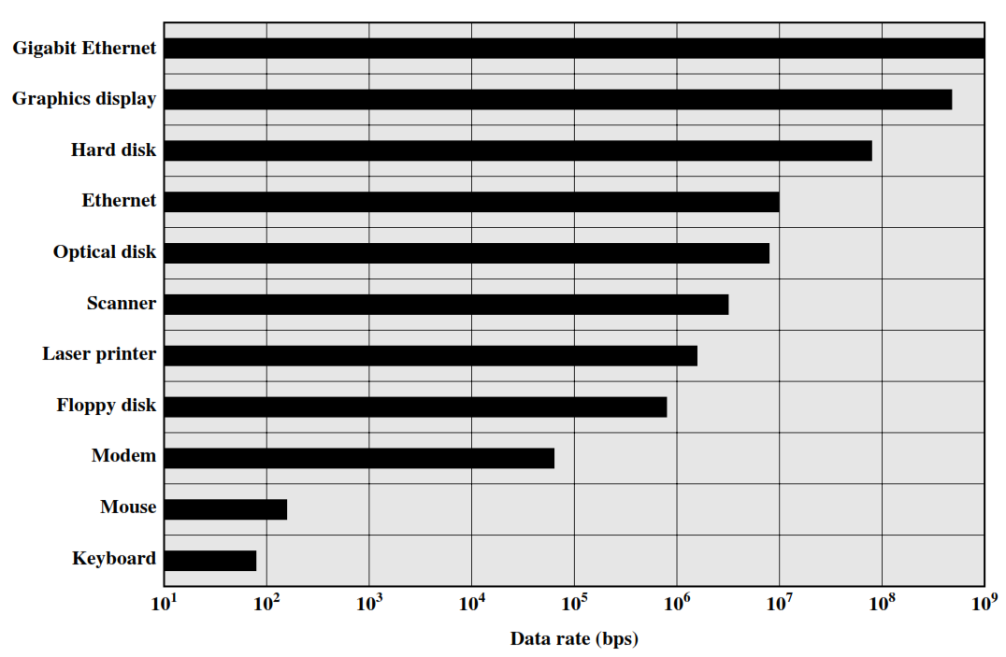
I/O Device Data Rate

Slide 9
Improvement in Chip Organization and Architecture
Increase hardware speed of processor
Shrinking the size of logic gates on processor reduces the propagation delay among them
Increase size and speed of cache that is near to processor
A portion of processor can be dedicated to cache
Changing the processor organization and architecture that can increase the instruction execution
Using parallelism

Slide 10
Memory Hierarchy
Total memory capacity can be visualized as hierarchy of components
As we go down the hierarchy, the following occurs
Decreasing cost per bit
Increasing capacity
Increasing access time
Decreasing frequency of access of the memory by the processor
Regis-ters
Inboard
Storage
Cache
Higher Speed, Smaller Size
Lower cost per Byte
Main Memory
Magnetic Disk
CD-ROM
CD-RW
DVD-RW
Outboard
Storage
Off-line Storage
Magnetic Tape

Slide 11
Memory Hierarchy
Main Memory (Primary Storage)
Only programs and data currently need by the processor are stored here
Auxiliary Memory (Secondary Storage)
Devices that provide backup storage
Magnetic disks and tapes
Cache
Increases the speed of processing
Rapid rate and smaller size
Compensates speed differences between main memory and processor
Stores segments of programs and data currently in use

Slide 12
Cache Memory
Small amount of fast memory
Sits between main memory and CPU
May be located on CPU chip
Faster than main memory by a factor of 5 to 10
Word Transfer
Block Transfer
Main Memory
CPU
Cache
Fast
Slow

Slide 13
Cache Operation
CPU requests contents of memory location
Check cache for this data
If present, get from cache (fast operation)
If not present, read required block from main memory to cache
Then deliver from cache to CPU

Slide 14
Cache Memory Operation
Start
Receive Address RA from CPU
Is block containing RA in cache?
No
Access Main Memory for block containing RA
Yes
Fetch RA word and deliver to CPU
Allocate cache line for Main Memory block
RA = Read Address
Done
Load Main Memory block into cache line
Deliver RA word to CPU

Slide 15
Cache Performance
When CPU refers to memory and finds the word in cache, it is said to produce a hit
If not found, it is called miss
Hit Ratio = Number of Hits/Total CPU references to memory

Slide 16
Elements of Cache Design (1/2)
A few basic design elements to classify and differentiate cache architecture
Cache Address
Logical
Physical
Cache Size
Mapping Function
Direct
Associative
Set Associative
Line Size

Slide 17
Elements of Cache Design (2/2)
Replacement Algorithm
Least Recently Used (LRU)
First in First out (FIFO)
Least Frequently Used (LFU)
Random
Write Policy
Write through
Write back
Write once
Number of Caches
Single or two level
Unified or Split

